Slide 1

Coffee Shop
By,
Sandeep Subbiah Selvakumar

Slide 2
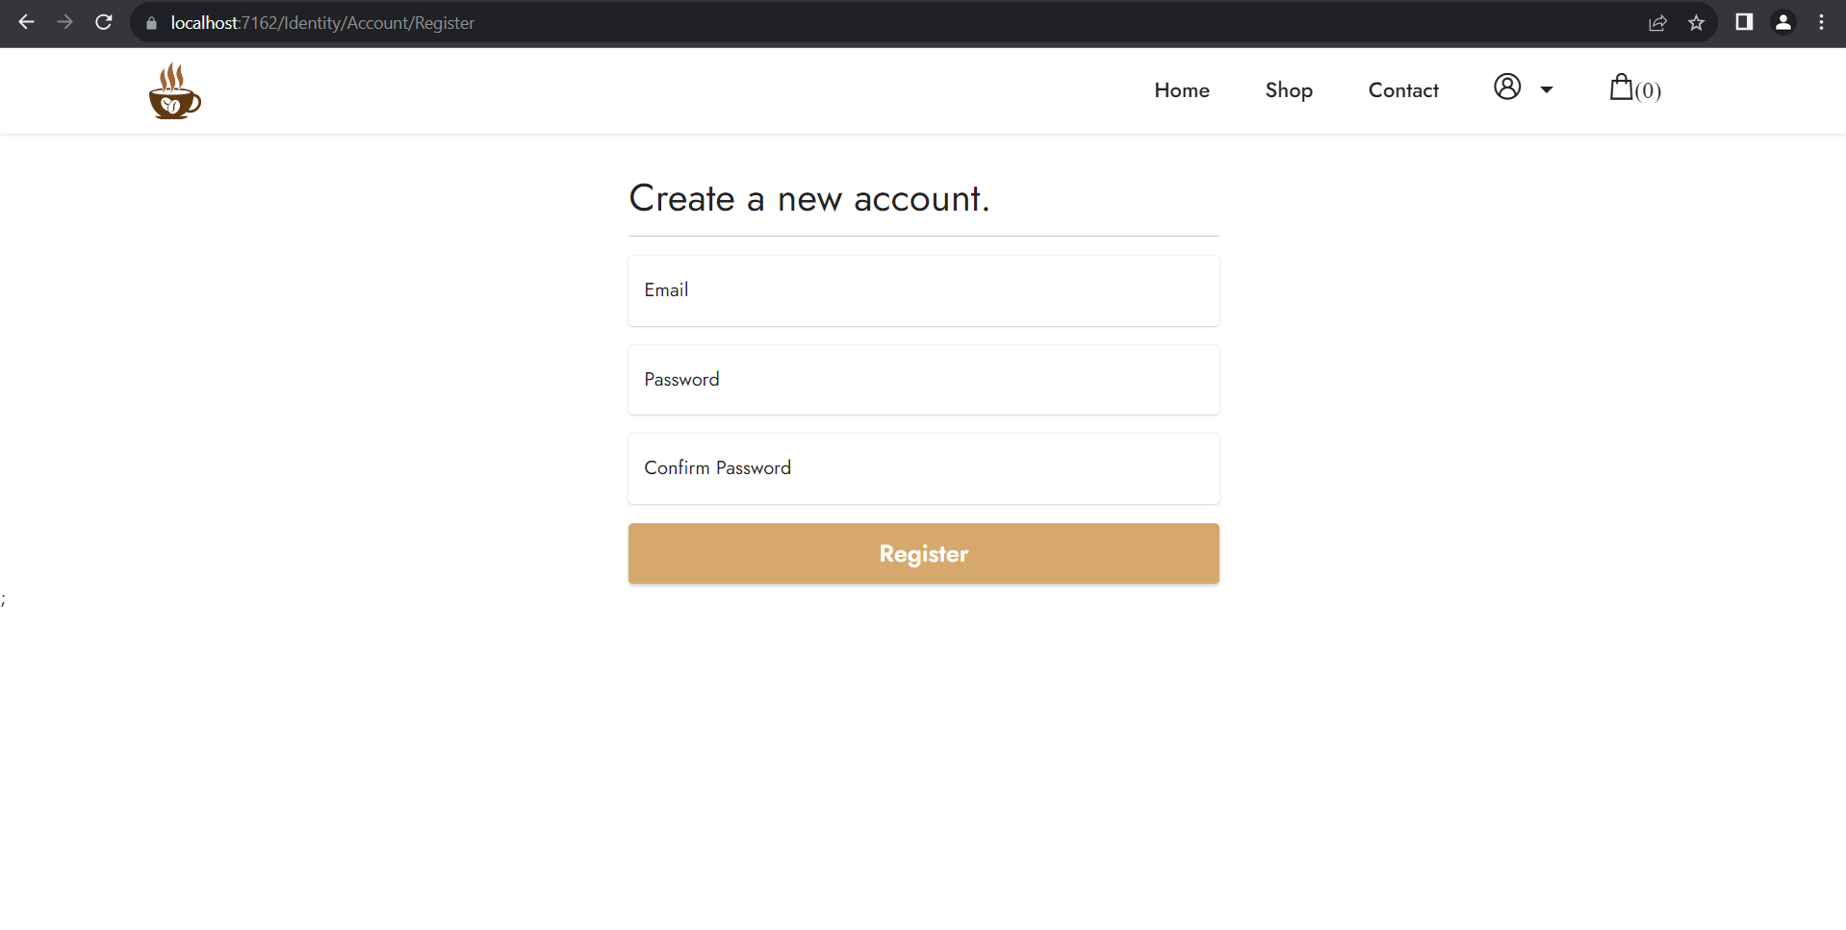
Register

Slide 3
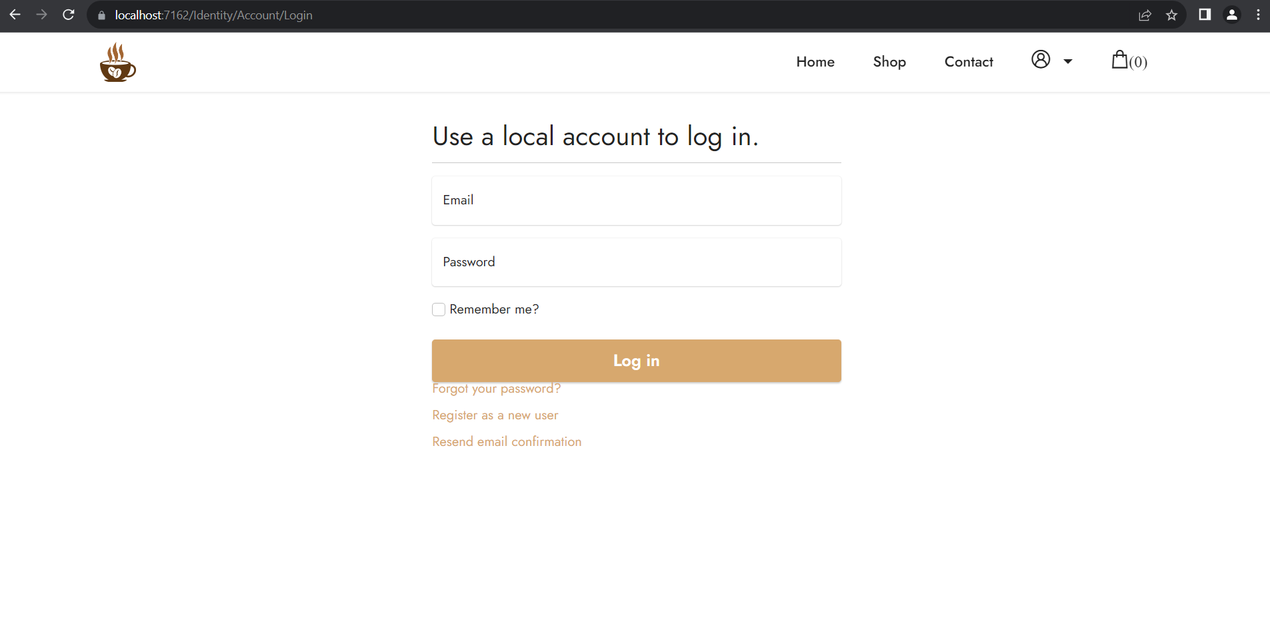
Login

Slide 4
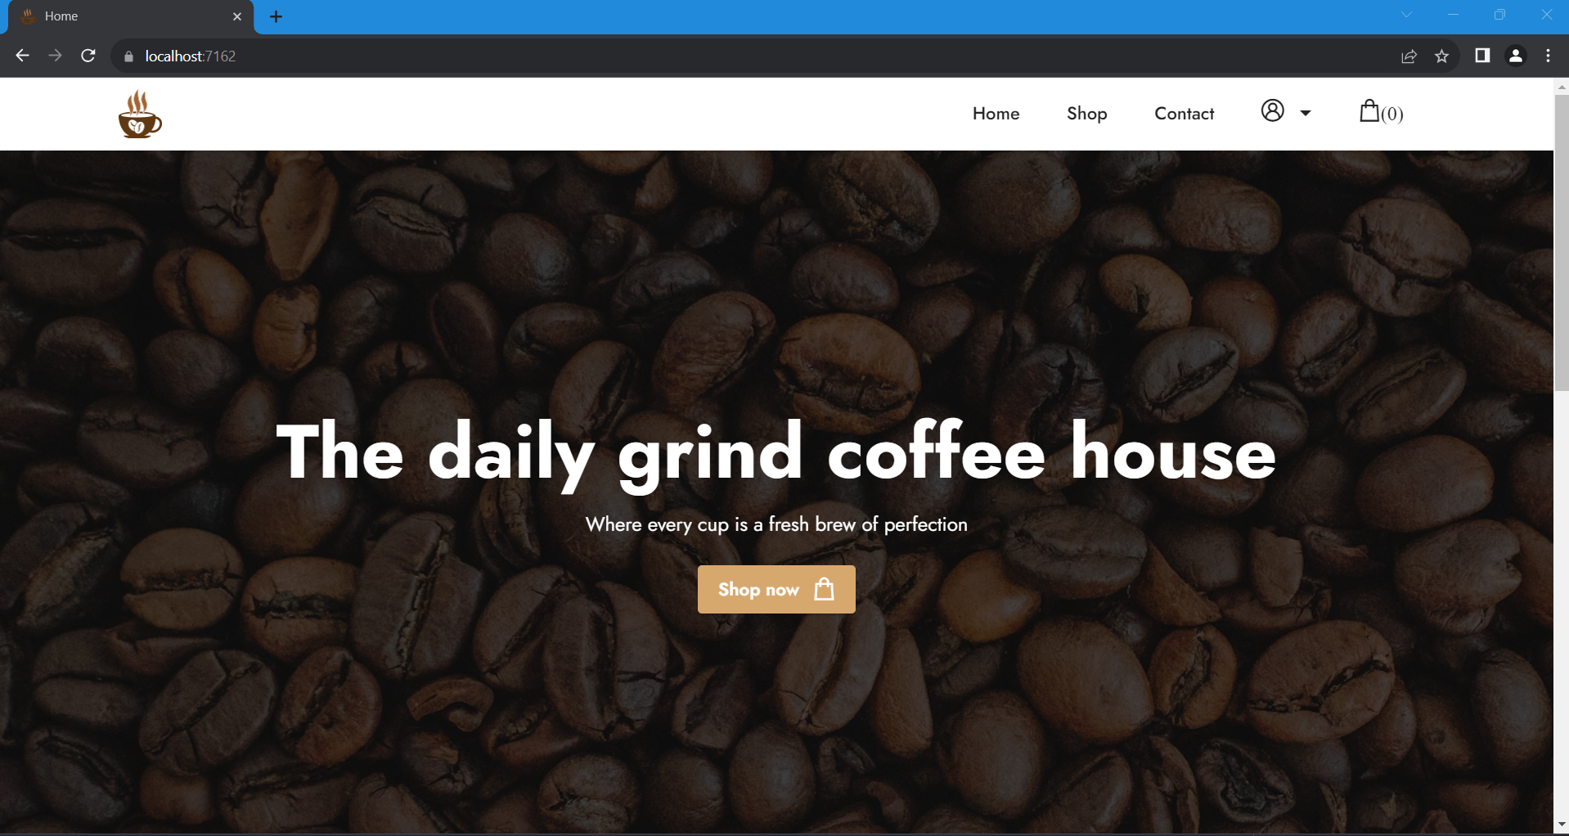
Landing Page

Slide 5
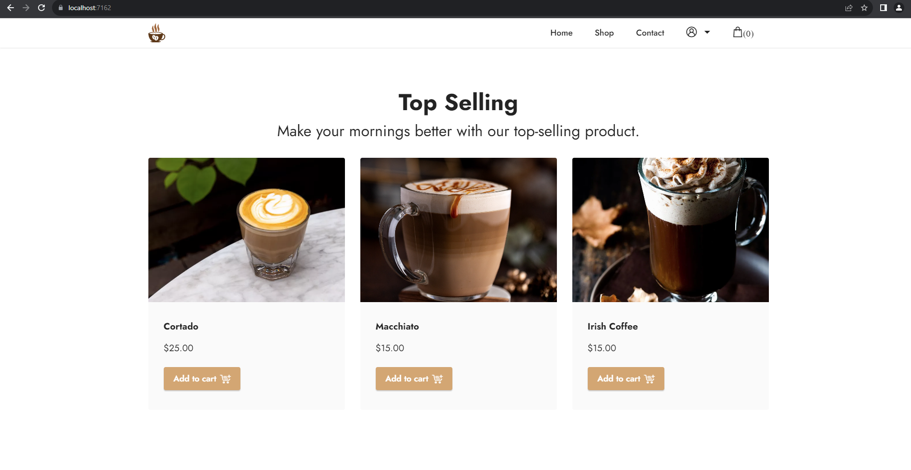
Landing page – Top Seller

Slide 6
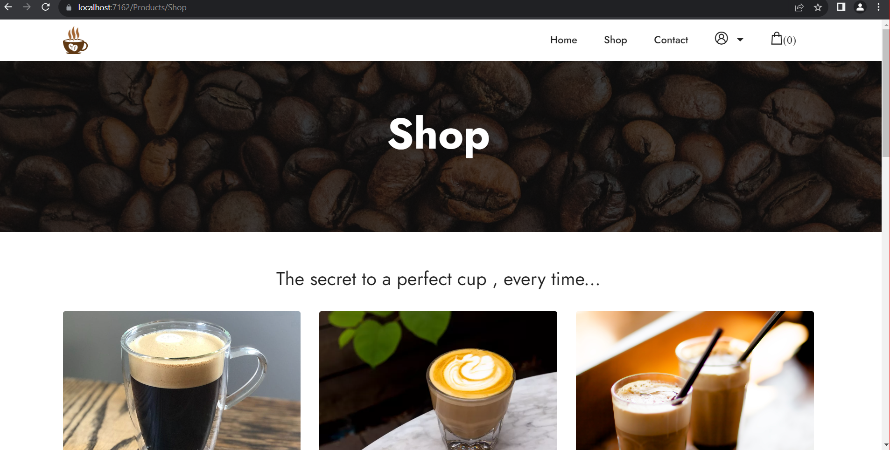
Shop - Products

Slide 7
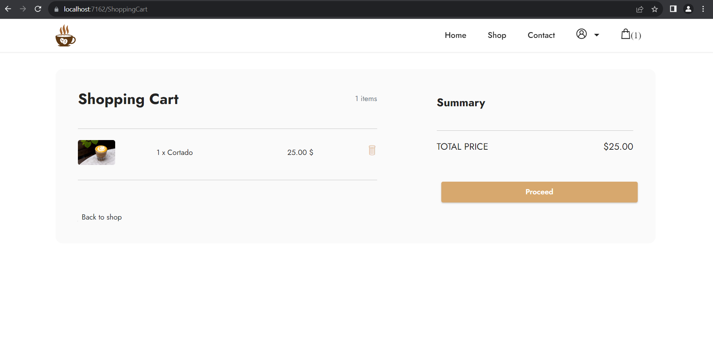
Shopping Cart

Slide 8
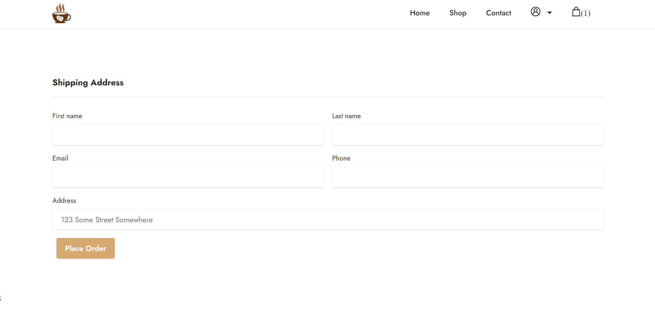
Shipping Details

Slide 9
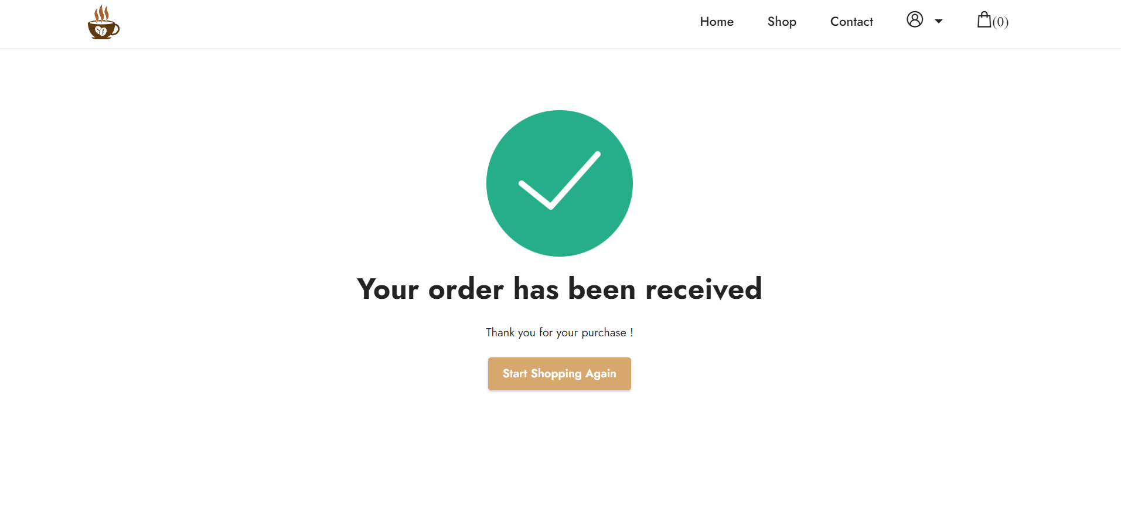
Order Confirmed

